Slide 1



Abbots Hall Primary Academy
Welcome to our SEND
(Special Educational Needs and Disability)
Information Report
2025 - 2026
Achieve, Believe, Create

Slide 2


Key People
Head Teacher
Mr. J. Arnold
Deputy Headteacher
Inclusion Lead / Mental Health Lead
Mr. S. Holmes
SENCo
Mrs. J. Adams
Family Support Worker
Miss D. Smith
Learning Mentor
Mrs. C. Foster
The Governor with responsibility for SEND is Sharyn Derrick

Slide 3





Our School’s Vision for SEND

Slide 4





What is SEND?
A child has SEND when:
They find learning harder than most children
They have a disability that makes it harder to use school facilities
They need support that is extra or different.

Slide 5


Slide 6











Types of SEND?
Cognition and Learning
dyslexia dyscalculia memory focus
Communication and Interaction
  Autism / ASD speech and language needs

Slide 7















Social, Emotional Mental Health (SEMH)
ADHD Anxiety Behaviour linked to emotions
Physical / Sensory needs
  Cerebral palsy dyspraxia hearing difficulty Blind / visually impaired
If a child has complex needs, we consider admissions on an individual basis

Slide 8

















How do we decide if a child has SEND?
We notice if a child :
Makes less progress than classmates
Does not close the learning gap
Finds learning harder even with extra help even
We get information from:
parents teachers
nurseries / previous schools /
outside experts like doctors or therapists like

Slide 9





How we support Children
Assess
Plan
Do
Review

Slide 10



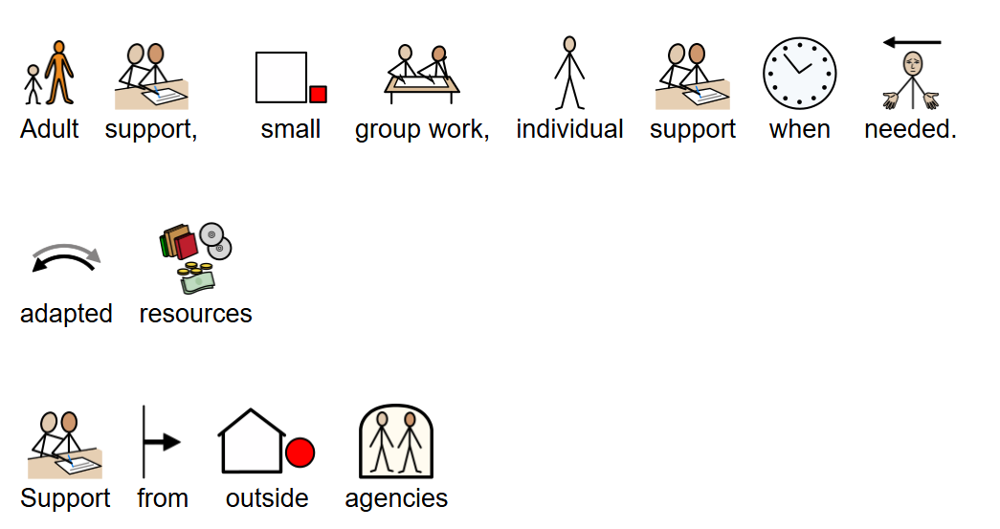
Assess, Plan, Do, Review
For All Children For Children with SEND

Slide 11

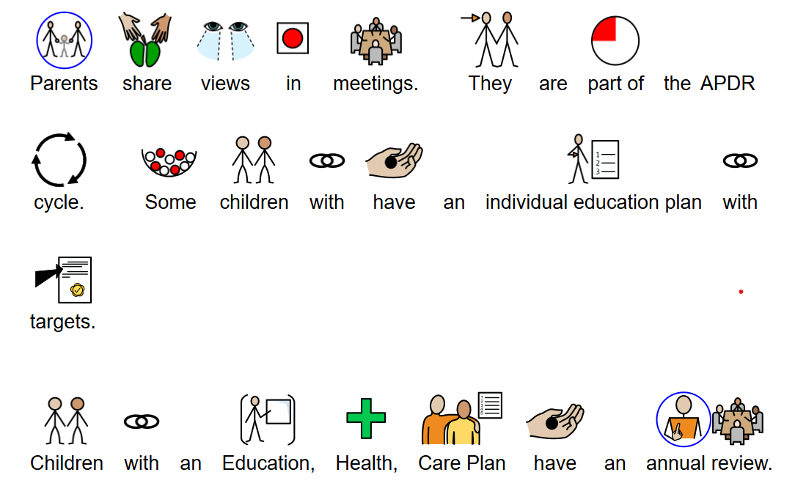
How Parents are Involved

Slide 12
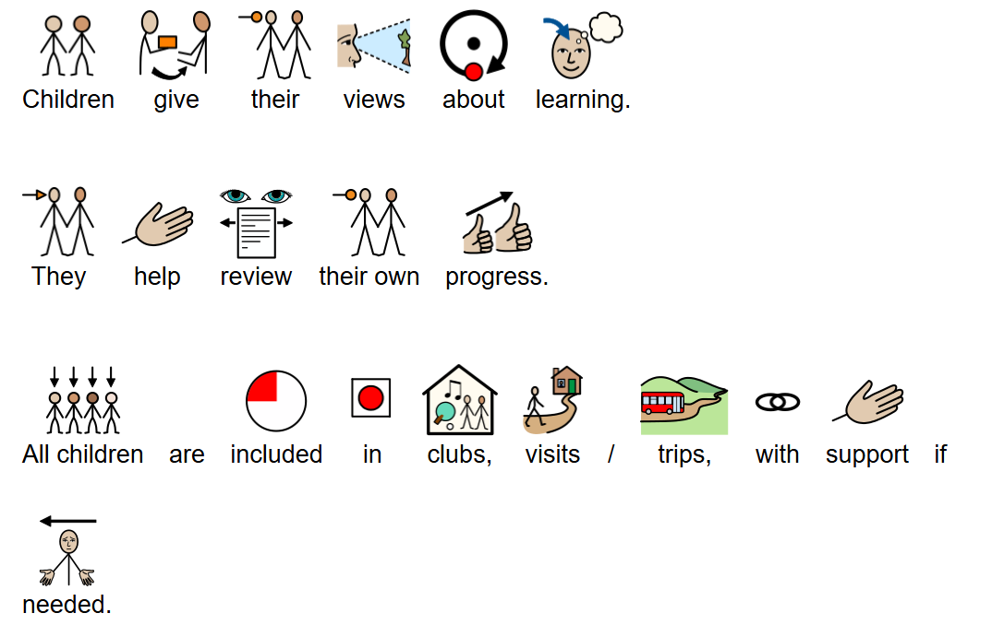
How are Children Involved

Slide 13
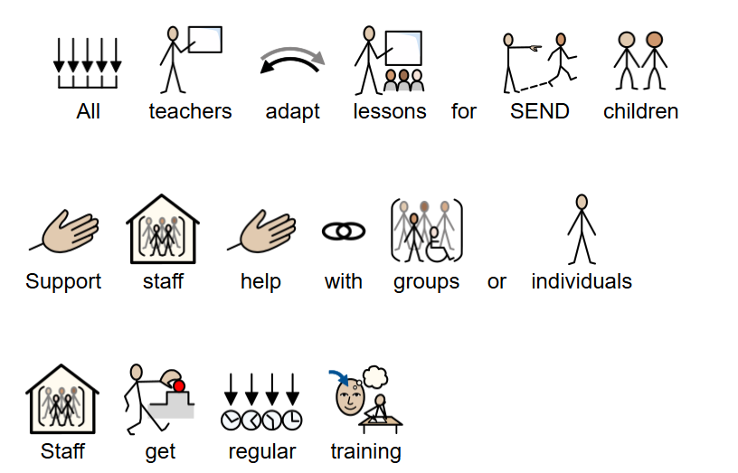
Teachers and Support Staff

Slide 14
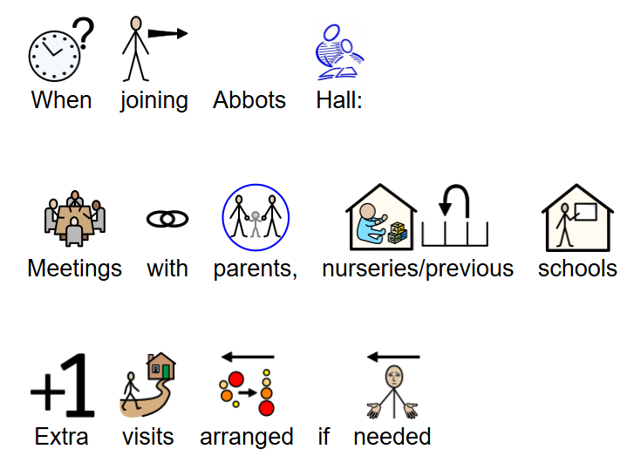

Slide 15


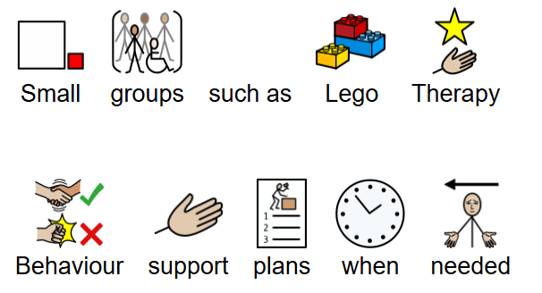
How we support children with social and emotional needs

Slide 16
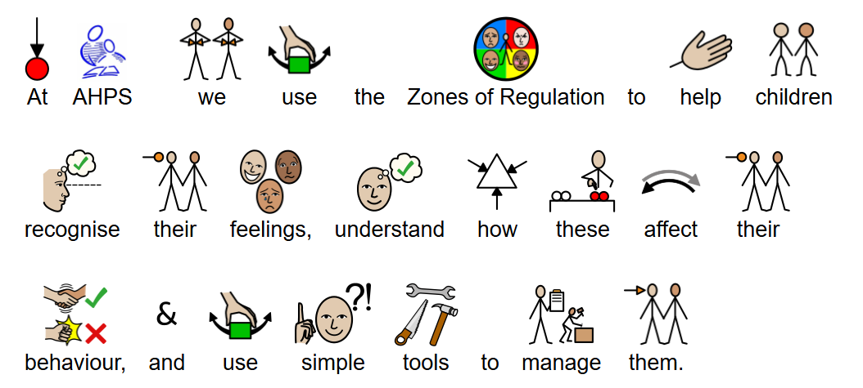
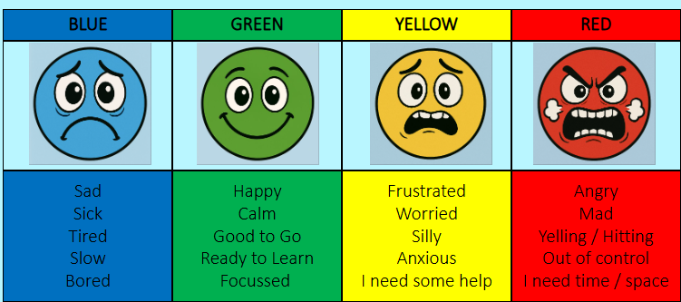
ZONES OF REGULATION

Slide 17

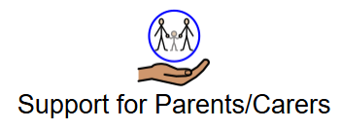

Support that is available for parents / carers

Slide 18

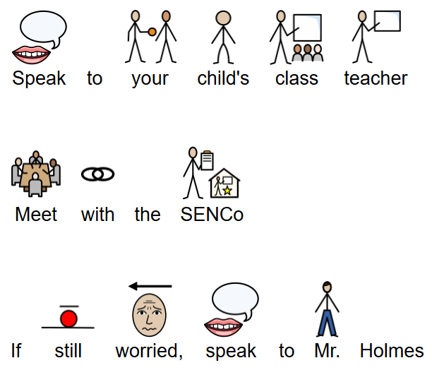
Further Information / Concerns

